Slide 1
Unit 3: Boolean Expressions and if Statements

AP CS A
Ms. Baniqued

Slide 2
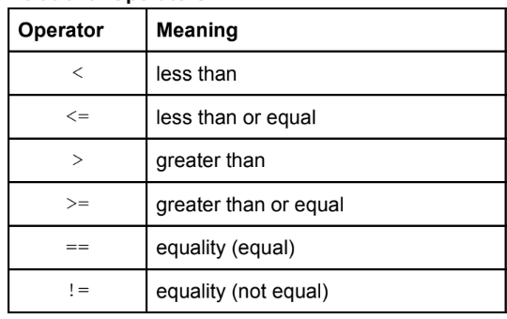
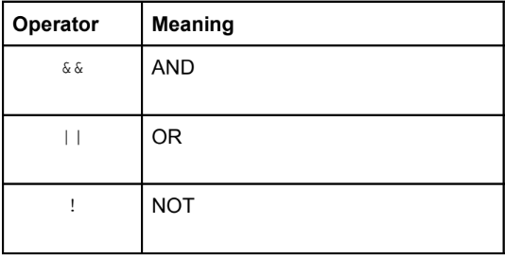
More Java Operators + Boolean Expressions
Which operators have we learned already?
Java has 2 types of operators that allow programmers to compare values and make decisions: Relational and Logical operators. Evaluating expressions that use relational or logical operators results in a boolean answer, true or false.
Relational Operators are used to compare values and determine their relationship.
Logical Operators are used to combine or manipulate boolean expressions.

Slide 3
Boolean Expressions
The result of a boolean expression evaluates to a single boolean value. This value can be assigned to a boolean variable.
Example:
boolean greaterThan = (100 > 150); // false
boolean isOdd = (60 % 2 != 0); // false
boolean isDivBy5 = (60 % 5 == 0); // true
boolean isOddAndDivBy5 = isOdd && isDivBy5; // false
boolean isOddOrDivBy5 = isOdd || isDivBy5; // true
When we use a relational or logical operator, there is a right-side and left-side. You should pay attention to precedence rules when evaluating these expressions.

Slide 4
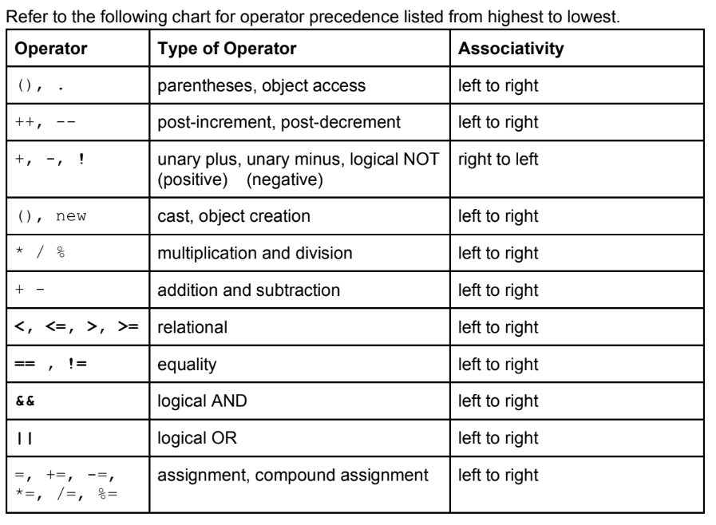
Operator Precedence Rules

Slide 5
Using Logical Operators
An AND operation requires both conditions to be met to evaluate as true. In Java, the && is used to represent an AND operation.
x == 5 && y >= 6
An OR operation requires either condition to be met to evaluate as true. In Java, the || is used to represent an OR operation.
x == 5 || y >= 6
A NOT operation reverses a boolean value, such that true evaluates to false and false evaluates to true. In Java the ! Is used to represent a NOT operation.
x != y

Slide 6
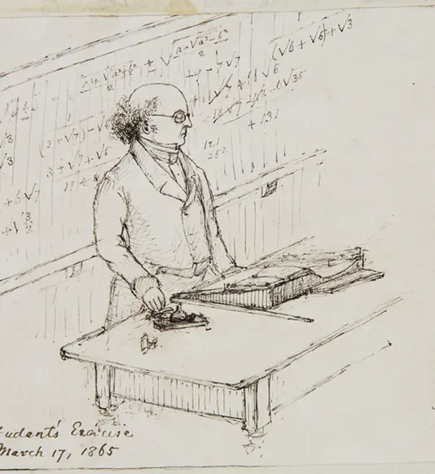
De Morgan’s Laws in Java Notation
In the expressions below, p and q are used to represent two boolean values or two boolean expressions (which evaluate to boolean values)
!(p && q) is the same as !p || !q
!(p || q) is the same as !p && !q
!(!p) is the same as p
The NOT operator should be applied to any logical operator, relational operator, or any boolean expression/value. It should not be applied to a non-boolean variable or value.
Knowing that both laws have two forms, the form you choose to use in a program is your preference. However, distributing the NOT operator tends to create more readable code.
x >= 5 && x < 10 is more readable than !(x < 5 || x >= 10)

Slide 7
Rewrite using De Morgan’s Law
(Assume A and B Represent Boolean Expressions)
!(A && B)

Slide 8
Rewrite using De Morgan’s Law
(Assume A and B Represent Boolean Expressions)
!(A && B)
Ans: !A || !B

Slide 9
Rewrite using De Morgan’s Law
(Assume A and B Represent Boolean Expressions)
!(A || B)

Slide 10
Rewrite using De Morgan’s Law
(Assume A and B Represent Boolean Expressions)
!(A || B)
Ans: !A && !B

Slide 11
Rewrite using De Morgan’s Law
(Assume A, B, and C Represent Boolean Expressions)
!(A && (B || C))

Slide 12
Rewrite using De Morgan’s Law
(Assume A and B Represent Boolean Expressions)
!(A && (B || C))
Ans: !A || (!B && !C)

Slide 13
Rewrite using De Morgan’s Law
(Assume A, B, and C Represent Boolean Expressions)
!((A && !B) || C)

Slide 14
Rewrite using De Morgan’s Law
(Assume A, B, and C Represent Boolean Expressions)
!((A && !B) || C)
Ans: (!A || B) && C

Slide 15
If Statements and Control Flow
A conditional statement in Java is a statement that allows the execution of specific code blocks based on the evaluation of one or more Boolean conditions.
Depending on the outcome of the evaluation of the condition, the program will decide which statement or block of statements to execute. Using conditional statements enables decision-making capabilities within the program and controls the flow of execution.
Conditional statements interrupt the sequential execution of statements. Instead of going top-down in executing our code, it jumps around.
There are 3 primary types of condition statements that use if (condition) in Java
if statement
if-else statement
if-else-if statement

Slide 16
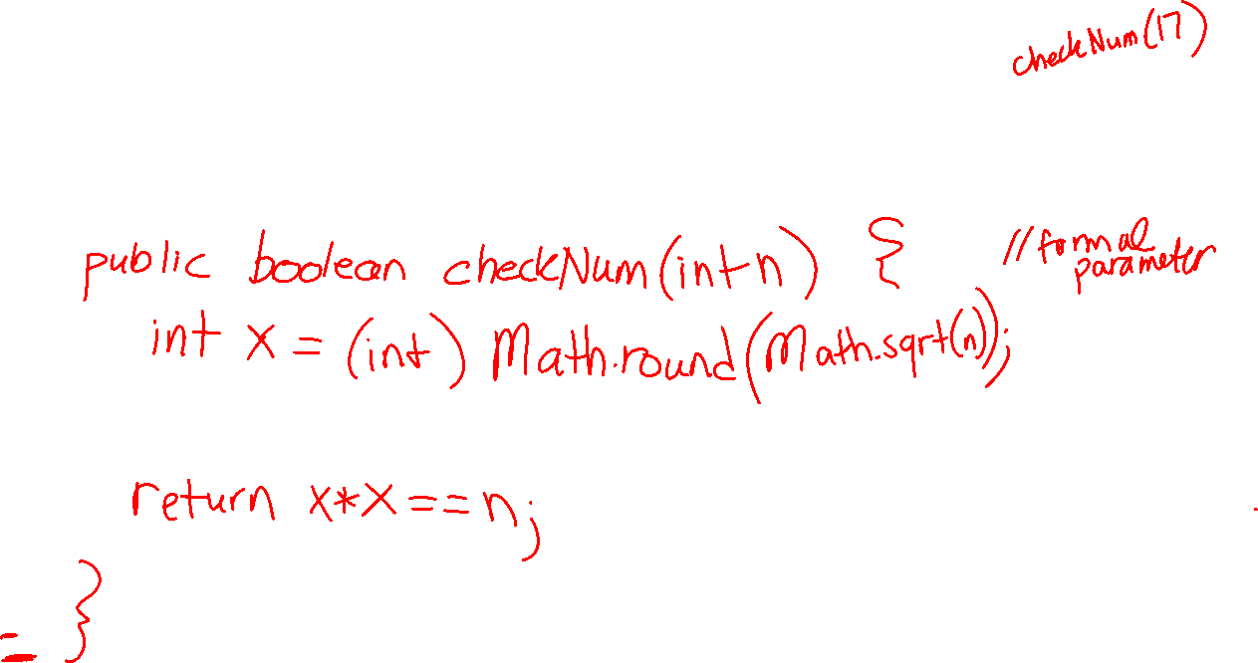
Practice
You need: Paper, pencil, correction pen
Write a boolean method checkNum that checks whether a given positive integer n is a perfect square. Use Math Class sqrt and round methods to find the square root of n, round it, then square the result and compare with n. Do not use any iterations (loops).

Slide 17
If Statements and Control Flow
if (condition1) {
// executes when condition1 is true
}
else if (condition2) { // checks condition2 if condition1 is not true
// this branch is checked when condition1 is not true AND condition2
// is true
}
else {
// if none of the above conditions evaluate to true, the else is executed
}
Example
Formatting conditional statements:
Always indent the code block/statements after an if or else
Get into the habit of using { } for the if and else clauses in all cases
Never put a semi-colon at the end of an if statement.
if (condition);
This often makes it past the compiler
and will likely cause a logic error, as
the code will not enter the if-block
(or the else block)
if (x > y) {
System.out.println(“x is greater than y”);
}
else if (x < y) {
System.out.println(“x is less than y”);
}
else { // what values of x and y will execute the else block?
System.out.println(“x is neither greater than or equal to y”);
}

Slide 18
Curly braces { } in if else statements
Syntax Notes: The if and else clauses in Java are designed to execute a single statement or a block of statements depending on the condition’s evaluation. If you don’t use braces { } to group multiple statements, only the first statement immediately following the if or else keyword will be considered part of the conditional statement. Any subsequent statements will be executed regardless of the condition’s outcome.
if (condition)
statement1; // executes when condition1 is true
else
statement2; // will execute if the condition is false
statement3; // will always execute, regardless of the condition
Causes an error:
if (condition)
statement1;
statement2; // without grouping { } statement2 causes an error (else without an if)
else
statement3;

Slide 19
if and else pairs
Syntax Notes:
The else clause in Java is always paired with the closest if in its block that does not have an else.
if (condition1)
if (condition2) // will execute if condition1 is true
statement1; // will execute if condition2 is true
else
statement2; // will execute if the condition2 is false
The else in this example is the else clause for if (condition2)regardless of the indentation.
To block the inner if statement from the else clause (pairing the else clause with the outer if statement), use braces:
if (condition1) {
if (condition2) // will execute if condition1 is true
statement1; // will execute if condition2 is true
}
else
statement2; // will execute if the condition1 is false

Slide 20
Precedence of Logical Operators NOT > AND > OR
The precedence of the logical operators when evaluating boolean expressions is:
NOT takes precedence over AND
AND takes precedence over OR
EXAMPLE:
true || false && false evaluates to true since you evaluate false && false first, which evaluates to false. From there, true || false evaluates to true.

Slide 21
